Slide 1
SonarQube
User Guide
DAY 9

Slide 2




Course Details
Overview
Browsing SonarQube
Measures Issues
Rules
Quality Profiles
Quality Gates

Slide 3
Overview
Sonarqube is a code quality management platform that allows developer teams to manage, track and improve the quality of the source code. It is written in Java but is able to analyze code in about 20 different programming languages
What to Measure?
Developer’s Seven Deadly Sins:
Bad Distribution of Complexity
Duplications
Lack of Unit Tests
No coding Standards
Not enough or Too many Comments
Potential Bugs
Spaghetti Design

Slide 4
Features
Languages Support - more than 20 different languages including Java, C#,C/C++,Cobol,PL/SQL,ABAP,Javascript, PHP,Web,XML etc are supported. Also offers the ability to add your own rules on those languages.
Pre-Commit Check - source code can be checked before pushing changes to the SCM: either directly in Eclipse or through a batch with the Issues Report Plugin. Both let you make sure that you are not introducing new quality issues.
Extend - it can be extended with the 60+ plugins that are available through the Sonarqube plugins library.
Time Machine - several methods are available to replay the past, showing how your metrics evolved. This will ensure progress get tracked over time.
Zoom to the source - Whatever you are looking at, a project, group of projects and so on, you can break down any metric in a few clicks, and drill down to the source of the information, the source code.
Security - complete mechanism for authentication and authorization is available out of the box, or through an external system such as LDAP.

Slide 5
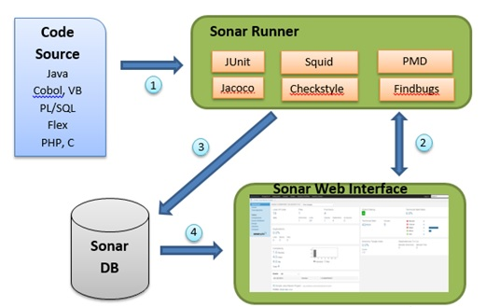
How Does Sonar Work?
Source
Code
Java, Cobol,
VB, PL/SQL, Flex,
PHP, C

Slide 6
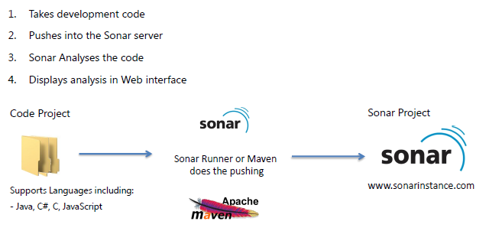
How Does Sonar Work?

Slide 7


Browsing Sonarqube
Interface Layout
Global Dashboards
Project Dashboards

Slide 8
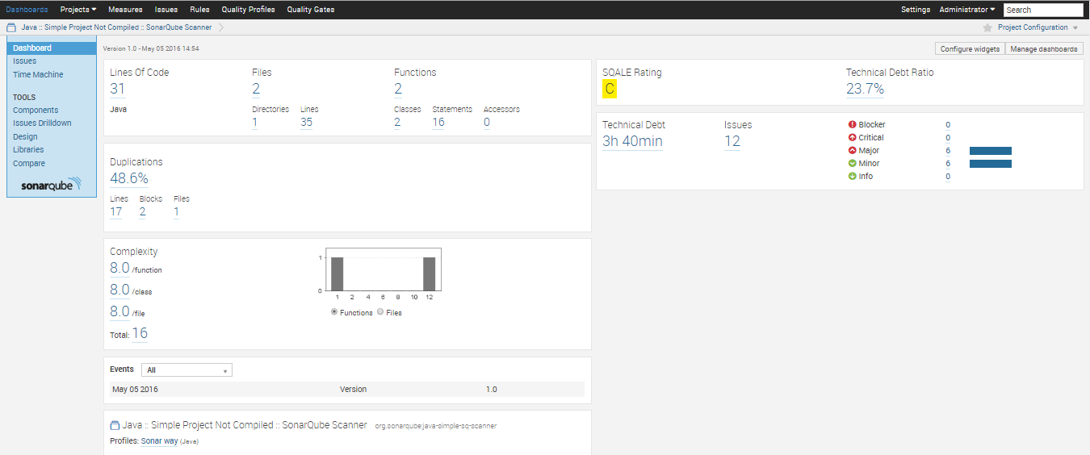
Interface Layout
Top Bar
Left Menu
Data Display

Slide 9
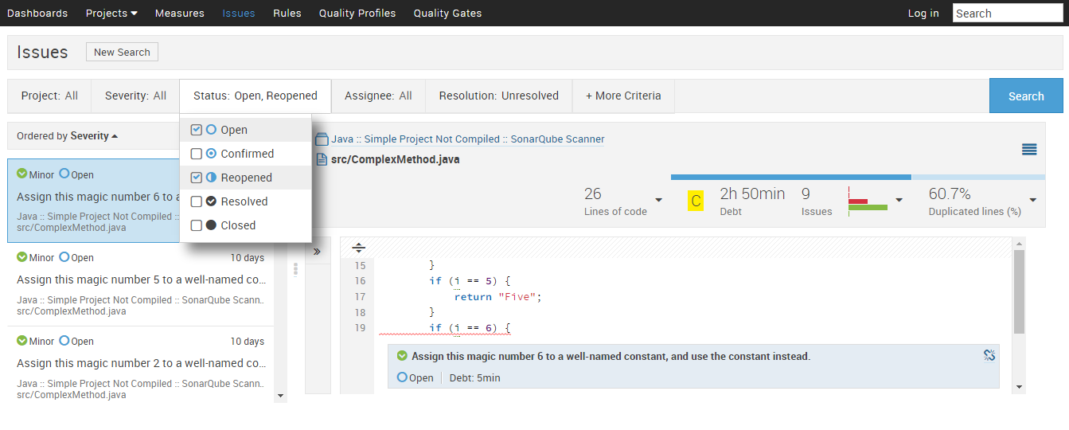
Interface Layout
Rules are executed on source code and which generate issues - that are used to compute technical debt.
Contains the complete list of Projects, Views, Developers, etc.
By clicking the Dashboards, the user will go back to the homepage
To view the issues service
To access the Measures service which provides a way to quickly execute all kinds of queries on project measures
This is where you define your requirements by defining sets of rules. You will find profiles grouped in language in this page.

Slide 10
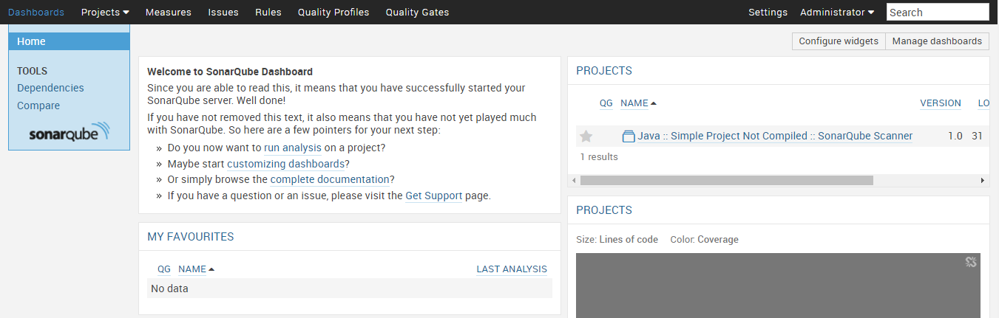
Global Dashboards
Global dashboards are available at the instance level, and can be accessed through the menu on the left when you're in a global context. Each box on this page is called a widget. Any widget can be added to a global dashboard. Thus, any kinds of information from a project or from the SonarQube instance can be displayed at will.

Slide 11
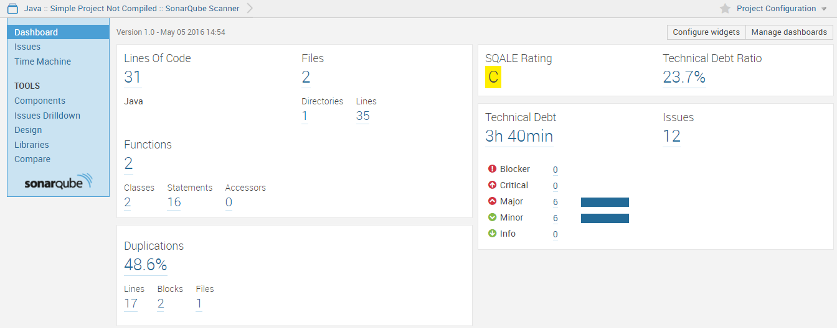
Project Dashboards
Project dashboards are the entry point when looking at a project. They display an overview of the project data: measures, issues, etc. Project dashboards typically contain only project widgets but the user can add any widgets as preferred.

Slide 12
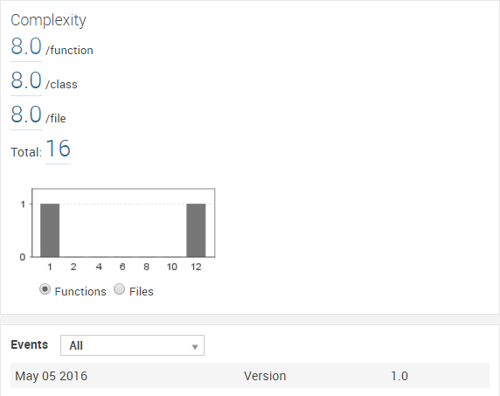
Project Dashboards
Project dashboards are the entry point when looking at a project. They display an overview of the project data: measures, issues, etc. Project dashboards typically contain only project widgets but the user can add any widgets as preferred.

Slide 13
Measures

Slide 14
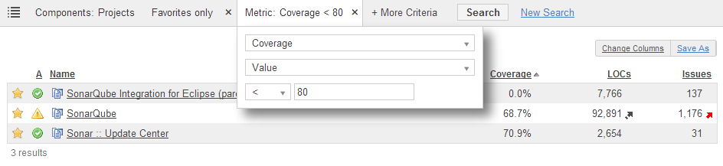
Measures
The Measures service provides a way to quickly execute all kinds of queries on project measures. It includes:
the recently inspected projects
the projects with blocker and critical issues
the projects with bad coverage on added/changed code within the 10 past days

Slide 15
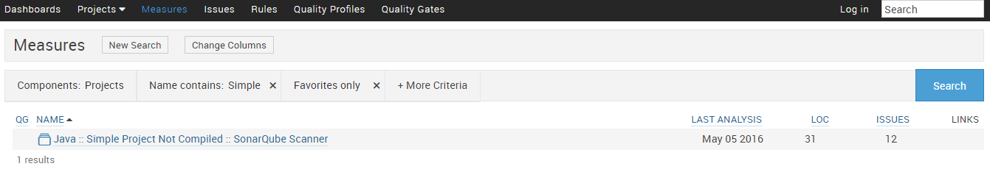
Measures
To add criteria on the search query, click on More Criteria and select as many criterion as you want.

Slide 16
Issues

Slide 17
Issues
While running an analysis, SonarQube raises an issue every time a piece of code breaks a coding rule. The set of coding rules is defined through the quality profile associated with the project. Developers can also manually raise issues that cannot be detected by SonarQube.
Severities:
BLOCKER
CRITICAL
MAJOR
MINOR
INFO
- Bug with a high probability to impact the behavior of the application in production: memory leak, unclosed JDBC connection, .... The code MUST be immediately fixed.
- Quality flaw which can highly impact the developer productivity: uncovered piece of code, duplicated blocks, unused parameters
- Either a bug with a low probability to impact the behavior of the application in production or an issue which represents a security flaw: empty catch block, SQL injection,etc. The code MUST be immediately reviewed
- Quality flaw which can slightly impact the developer productivity: lines should not be too long, "switch" statements should have at least 3 cases
- Neither a bug nor a quality flaw, just a finding

Slide 18
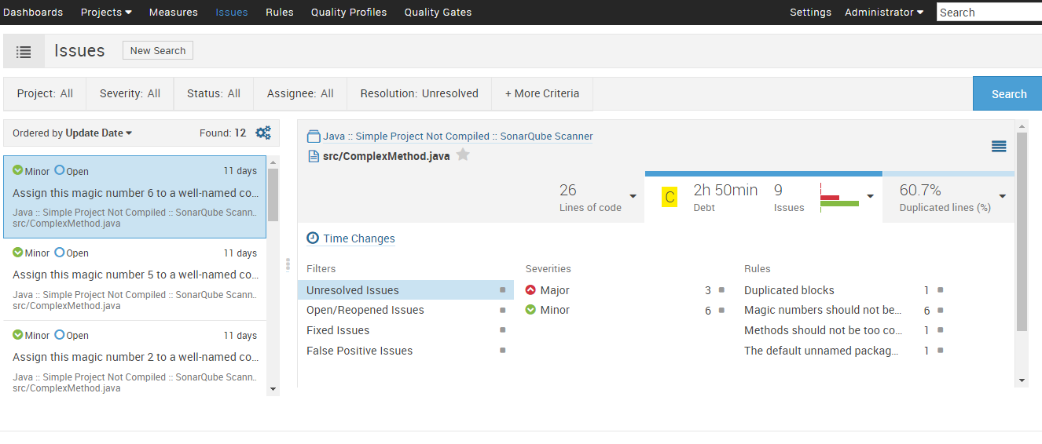
Measures

Slide 19
Rules

Slide 20
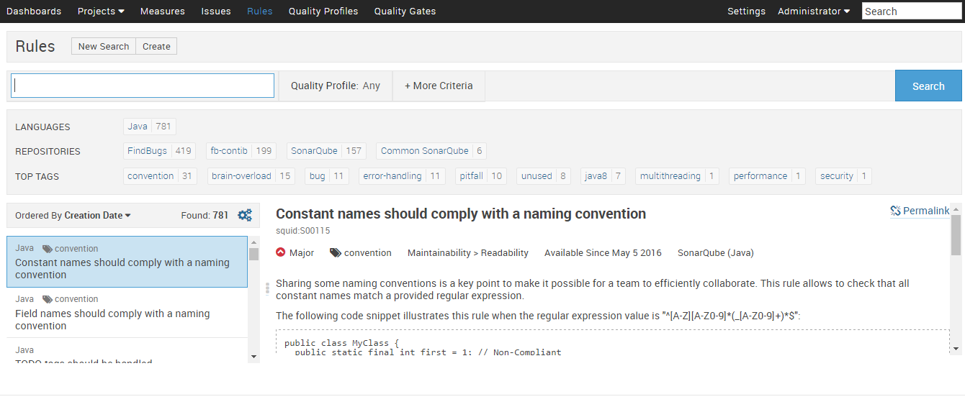
Rules

Slide 21
Quality Profiles

Slide 22
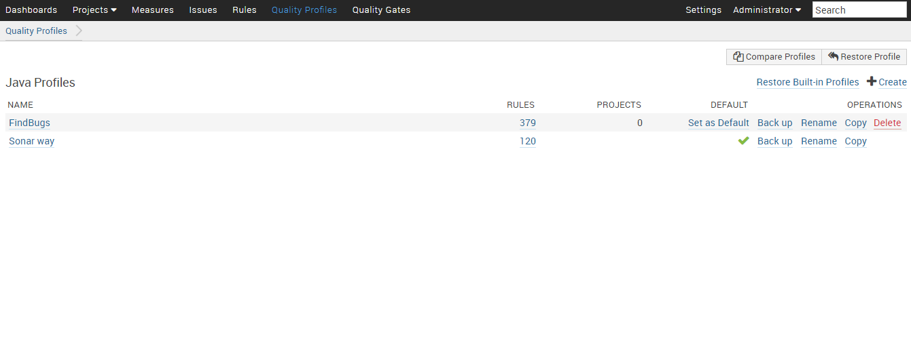
Quality Profiles

Slide 23
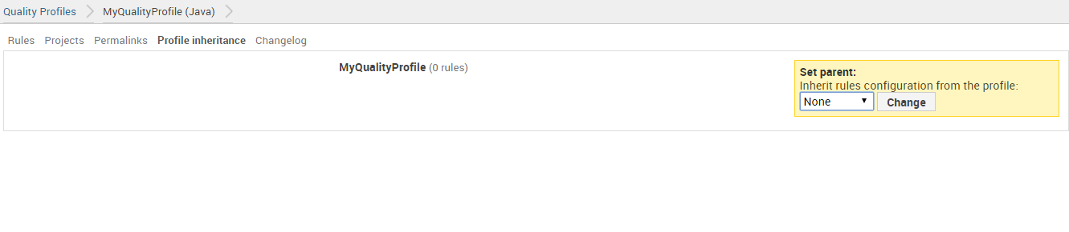
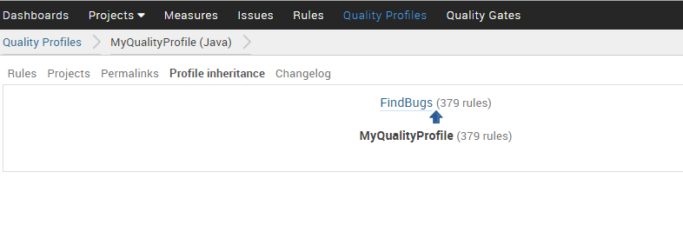
Quality Profiles

Slide 24
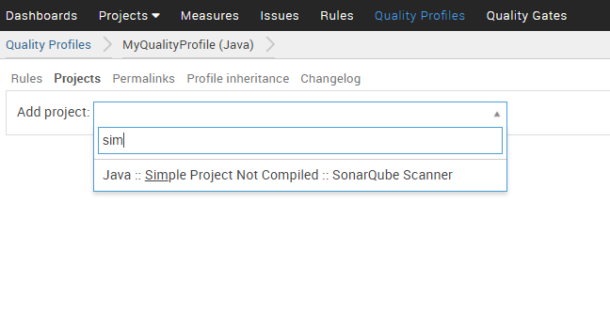
Quality Profiles

Slide 25
Quality Gates

Slide 26
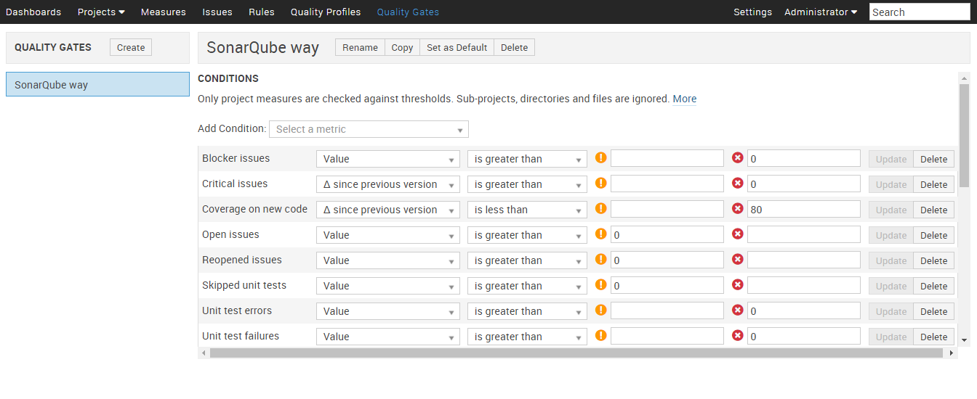
Quality Gates
Quality gates is a set of conditions and a set of projects to be checked against these conditions. It define your requirements on projects. Requirements are set against measures.

Slide 27
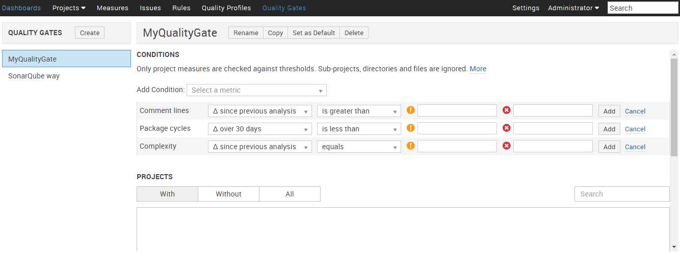
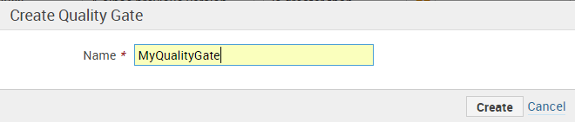
Quality Gates

Slide 28
END

